Slide 1

Perancangan Sistem Pemrograman
Domain Models
Prepared by Frans Panduwinata, S.Kom, M.T

Slide 2

What is a Domain Model?
A domain model is a visual representation of conceptual classes or real-situation objects in a domain.
Domain models have also been called conceptual models.

Slide 3
What is a Domain Model? (cont)
Applying UML notation, a domain model is illustrated with a set of class diagrams in which no operations are defined.
It provides a conceptual perspective. It may show:
  domain objects or conceptual classes
  associations between conceptual classes
  attributes of conceptual classes

Slide 4
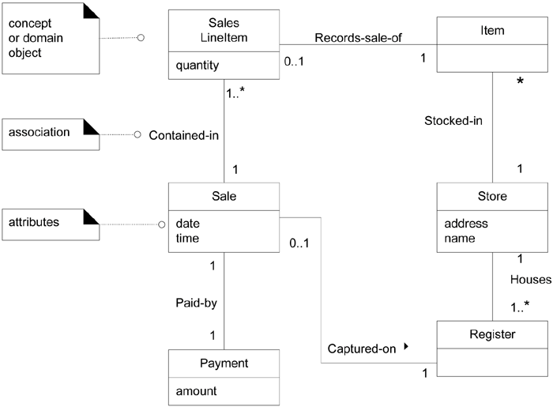
What is a Domain Model? (cont)
EXAMPLE:

Slide 5
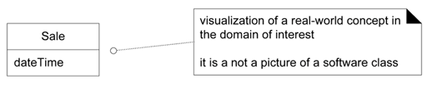
What is a Domain Model? (cont)
A domain model shows real-situation conceptual classes, NOT software classes.

Slide 6
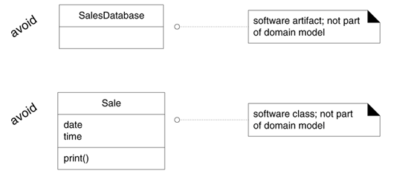
What is a Domain Model? (cont)
A domain model DOES NOT show software artifacts or classes.

Slide 7
What are Conceptual Classes?
a conceptual class is an idea, thing, or object.
a conceptual class may be considered in terms of its symbol, intension, and extension
  Symbol words or images representing a conceptual class.
  Intension the definition of a conceptual class.
  Extension the set of examples to which the conceptual class applies.

Slide 8
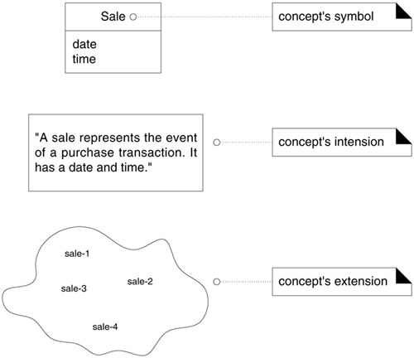
What are Conceptual Classes? (cont)

Slide 9
Why Create a Domain Model?
Lower representational gap with OO modeling
This is a key idea in OO:
  Use software class names in the domain layer inspired from names in the domain model, with objects having domain-familiar information and responsibilities.

Slide 10
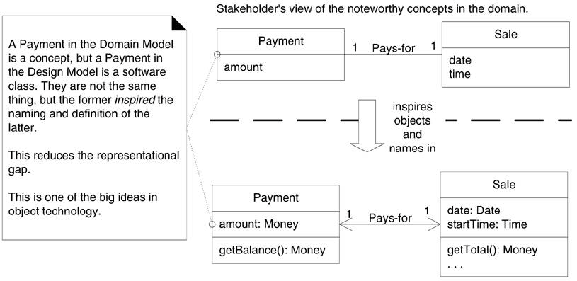
Why Create a Domain Model? (cont)
The object-oriented developer has taken inspiration from the real world domain in creating software classes.
Therefore, the representational gap between how stakeholders conceive the domain, and its representation in software, has been lowered.

Slide 11
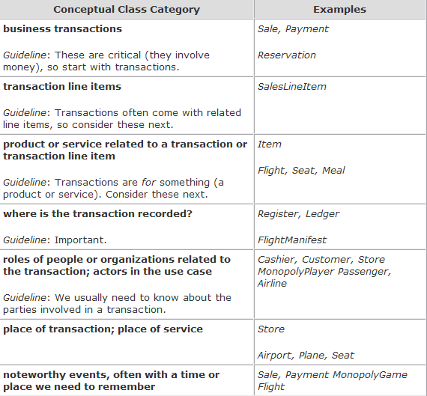
How to Find Conceptual Classes?
One method that
we can use is
category list

Slide 12
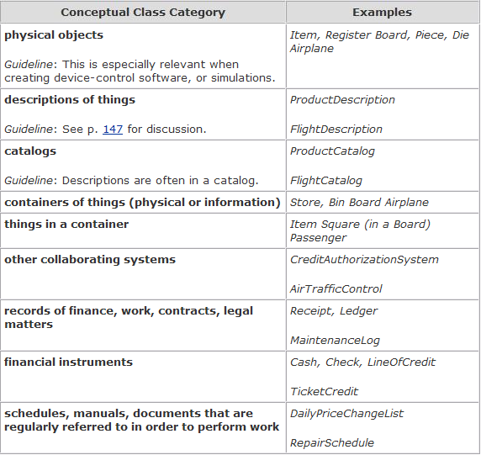
How to Find Conceptual Classes? (cont)

Slide 13
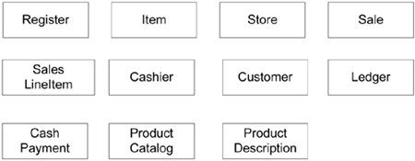
EXAMPLE: Initial POS Domain Model
a UML class diagram of the conceptual classes from POS

Slide 14
A Common Mistake with Attributes vs. Classes
The most common mistake when creating a domain model is to represent something as an attribute when it should have been a conceptual class
If we do not think of some conceptual class X as a number or text in the real world, X is probably a conceptual class, not an attribute.

Slide 15

A Common Mistake with Attributes vs. Classes (cont)
As an example, should store be an attribute of Sale, or a separate conceptual class Store?
In the real world,
a store is not considered a number or text the term suggests a legal entity, an organization, and something that occupies space.
Therefore, Store should be a conceptual class.

Slide 16

A Common Mistake with Attributes vs. Classes (cont)
As another example, consider the domain of airline reservations. Should destination be an attribute of Flight, or a separate conceptual class Airport?
In the real world,
a destination airport is not considered a number or textit is a massive thing that occupies space.
Therefore, Airport should be a concept.

Slide 17
Description Classes
A description class contains information that describes something else.
For EXAMPLE,
a ProductDescription that records the price, picture, and text description of an Item.

Slide 18
Why Use Description classes?
The need for description classes is common in sales, product, and service domains.
It is also common in manufacturing, which requires a description of a manufactured thing that is distinct from the thing itself.

Slide 19
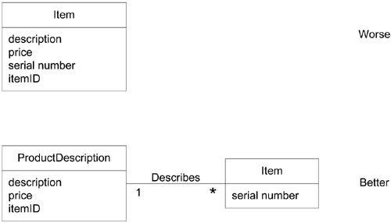
Why Use Description classes? (cont)
EXAMPLE:
  To solve the Item problem, what is needed is a ProductDescription class that records information about items.
  A ProductDescription does not represent an Item, it represents a description of information about items.

Slide 20
When Are Description Classes Useful?
Add a description class (for example, ProductDescription) when:
  There needs to be a description about an item or service, independent of the current existence of any examples of those items or services.
  Deleting instances of things they describe (for example, Item) results in a loss of information that needs to be maintained, but was incorrectly associated with the deleted thing.

Slide 21
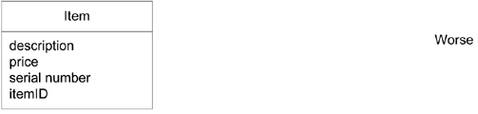
When Are Description Classes Useful? (cont)
Add a description class (for example, ProductDescription) when (cont):
  It reduces redundant or duplicated information.
  EXAMPLE:
  the description, price, and itemID are duplicated for every Item instance of the same product.

Slide 22
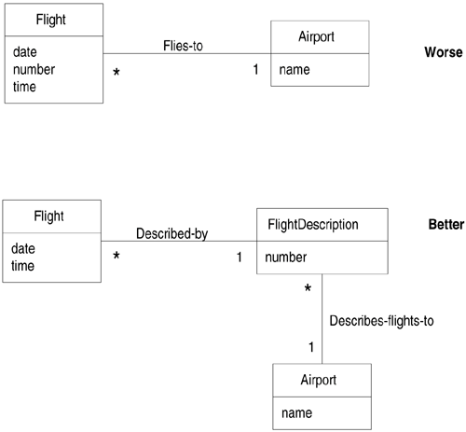
EXAMPLE: Description Class

Slide 23
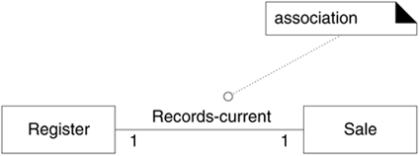
Associations
An association is a relationship between classes that indicates some meaningful and interesting connection.
EXAMPLE:

Slide 24
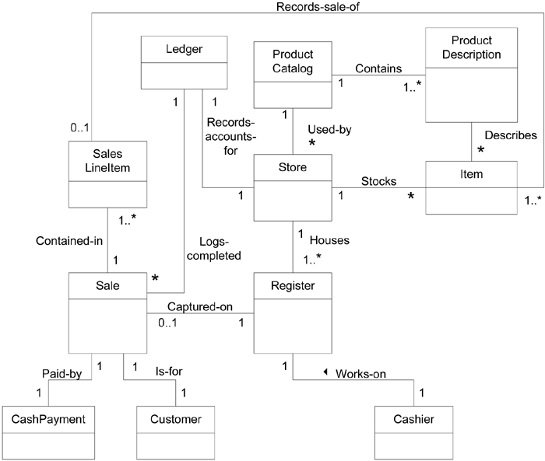
Associations in the Domain Models
Case Study:
NextGen POS

Slide 25
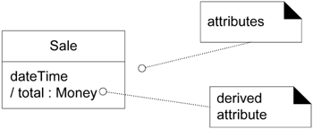
Attributes
An attribute is a logical data value of an object.
EXAMPLE:

Slide 26
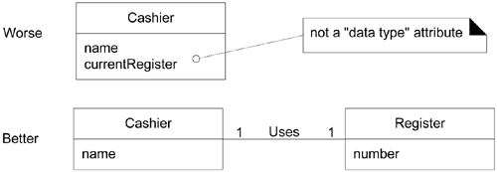
Attributes (cont)
Focus on data type attributes in the Domain Model
For EXAMPLE,
the currentRegister attribute in the Cashier class is undesirable
because its type is meant to be a Register,
which is not a simple data type (such as Number or String).
The most useful way to express that a Cashier uses a Register is with an association, NOT WITH an attribute.

Slide 27
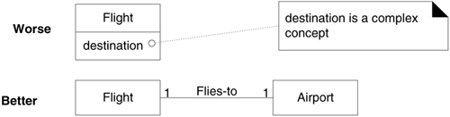
Attributes (cont)
DON‘T show complex concepts as attributes but instead use an associations.
For EXAMPLE,
a destination airport is not really a string;
it is a complex thing that occupies many square kilometers of space.
Therefore, Flight should be related to Airport via an association, not with an attribute

Slide 28
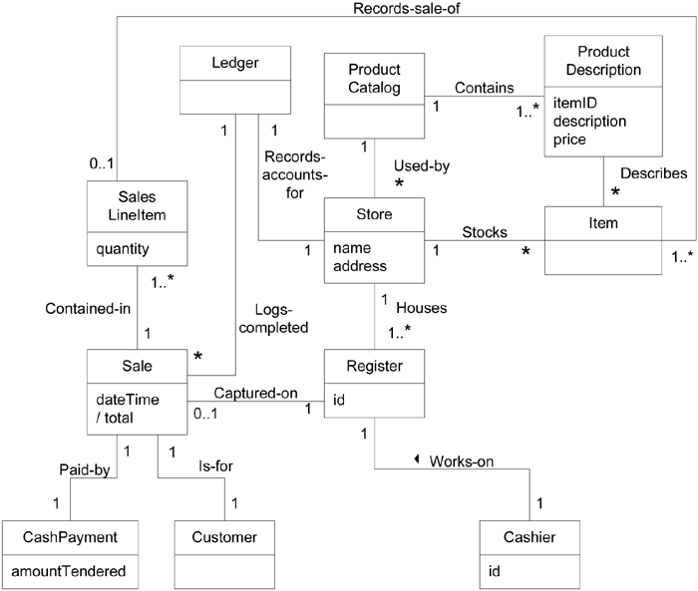
Attributes in the Domain Models
Case Study:
NextGen POS
EXAMPLE:
SalesLineItem -
quantity
To record the
quantity entered,
when there is more
than one item in a
line item sale
(for example, five
packages of tofu).

